Slide 1




How We Create Content
(and How You Can Use It)
Create
Making content work harder so you don’t have to
Optimize
WEBINAR
Publish
Natalie Slyman
Content Marketing Manager
A practical walkthrough of the content engine and how the team can use it every day
Notes:
This webinar is a behind-the-scenes look at how the Benchmark Email content team operates day to day. The goal isn't just to show what we make; it's to show how we make it, and more importantly, how the rest of the team can put it to work. By the end, you should walk away with a clear picture of the process and at least one way you can start using content more effectively in your own role.

Slide 2
02
Why This Matters
Content should make your job easier
⚡
💬
🤝
Close deals faster
Answer questions quicker
Build trust without extra work
Speed up the path from first question to sale.
Provide explanations to questions and inquiries.
Teach first, sell second, and let content do the heavy lifting.
Notes:
Before getting into the how, it's worth grounding this in the why. Content isn't just a marketing function. It's a tool that every team can use. When it's working well, it helps sales move deals forward faster by giving prospects useful context before they ever ask for it. It helps support answer recurring questions without starting from scratch every time. And it builds trust with potential customers without requiring anyone to manually establish that trust in every single conversation. The core principle here is simple: teach first, sell second.

Slide 3


01
How we create content
02
What we create
What we’ll cover
03
How you can use it
04
Where to find it
Notes:
We'll move through four areas today. First, how we actually create content, including the process, the tools, and the decisions behind it. Second, what kinds of content we produce and why. Third, how different teams across the company can actively use what we publish. And fourth, where to find it when you need it. It's a practical walkthrough, so feel free to take notes on anything you want to apply to your own work.

Slide 4
Our Content Process
04
From idea → published content
01
02
03
04
05
Brainstorm
Validate
Create
Optimize
Publish
This is the repeatable system behind every piece we publish.
Notes:
Every piece of content we publish goes through the same five stages: Brainstorm, Validate, Create, Optimize, and Publish. This isn't a rigid checklist, however it's a repeatable system that keeps us from skipping steps that matter. The most commonly skipped step across content teams is Validate. A lot of people go straight from idea to creation and end up producing something nobody was looking for. This process is designed to prevent that.

Slide 5
Brainstorm Topics
05
Where ideas come from
🧲
🛟
Tools we use
Sales conversations
Support questions
What prospects ask during outreach and demos.
Repeated friction points and troubleshooting needs.
• ChatGPT and Claude for framing and ideation
• AirOps for workflow support and recommendations
Best ideas usually start with what the team hears every day.
🧩
📈
Product gaps
Industry trends
Places where the market needs more clarity.
Timely shifts, competitor changes, and search demand.
Notes:
The best topic ideas don't come from staring at a blank calendar. They come from paying attention to what's already happening around you. Sales conversations are one of the richest sources: if a prospect asks the same question in three different demos, that's a blog post waiting to be written. Support tickets surface friction points that real customers are hitting. Product gaps show us where the market needs more clarity. And industry shifts, competitor changes, new tools, algorithm updates, give us timely topics to jump on while people are actively searching. We use Claude for framing and angle development, and AirOps to support the workflow and surface recommendations we might otherwise miss.

Slide 6

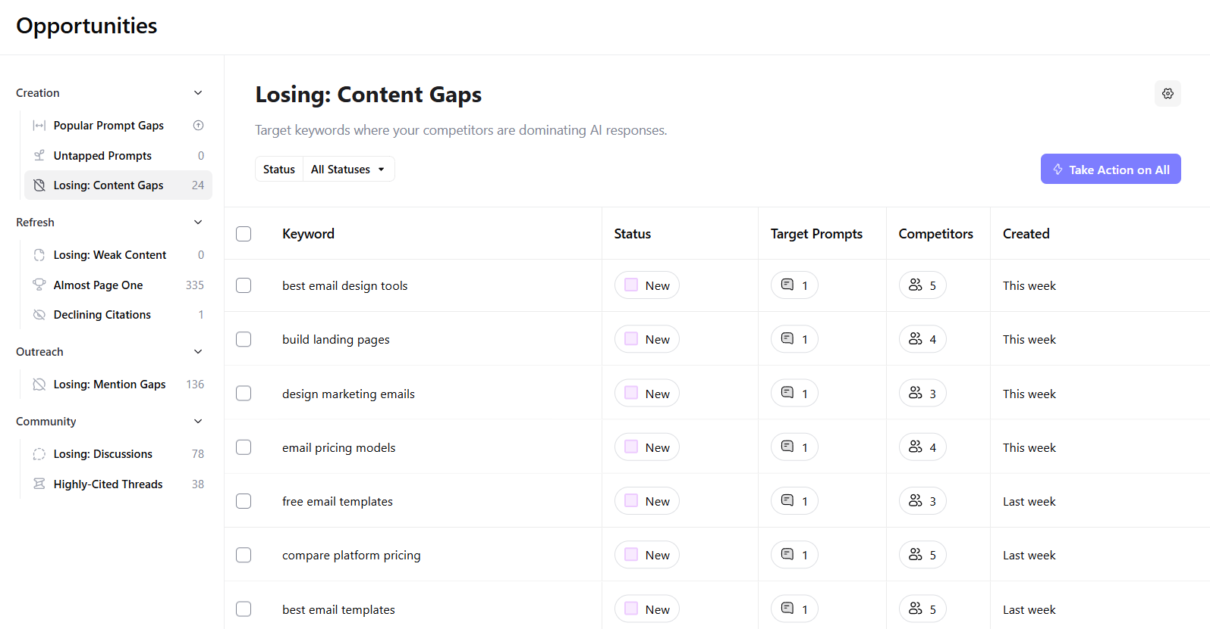
Validate Ideas
06
Recommendations
We don’t guess. We validate.
Notes:
Once we have a topic idea, we don't just run with it, we validate it. One of the main views we use in AirOps is the Content Gaps folder, which surfaces keywords where competitors are currently outperforming us in AI responses. This tells us where there's real demand that we're not yet meeting. If a topic shows up here, it's a signal worth acting on. Validation isn't about second-guessing good ideas; it's about making sure we're investing time in things that will actually move the needle.

Slide 7
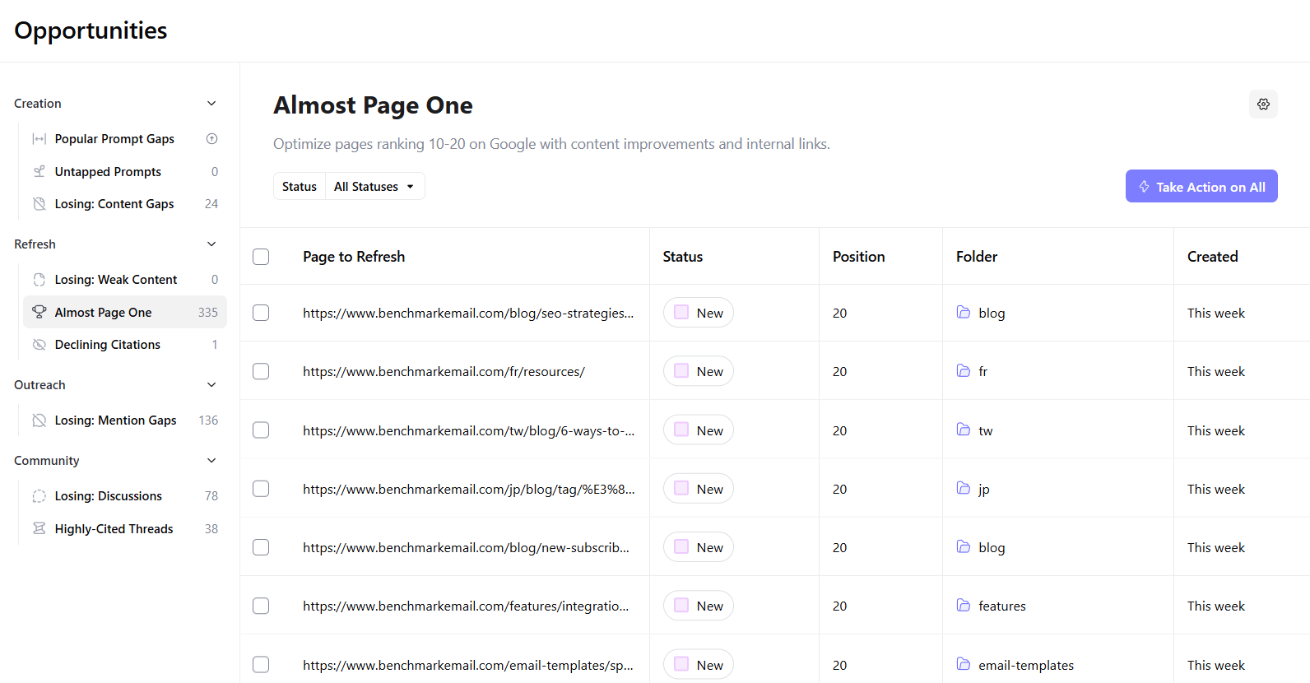
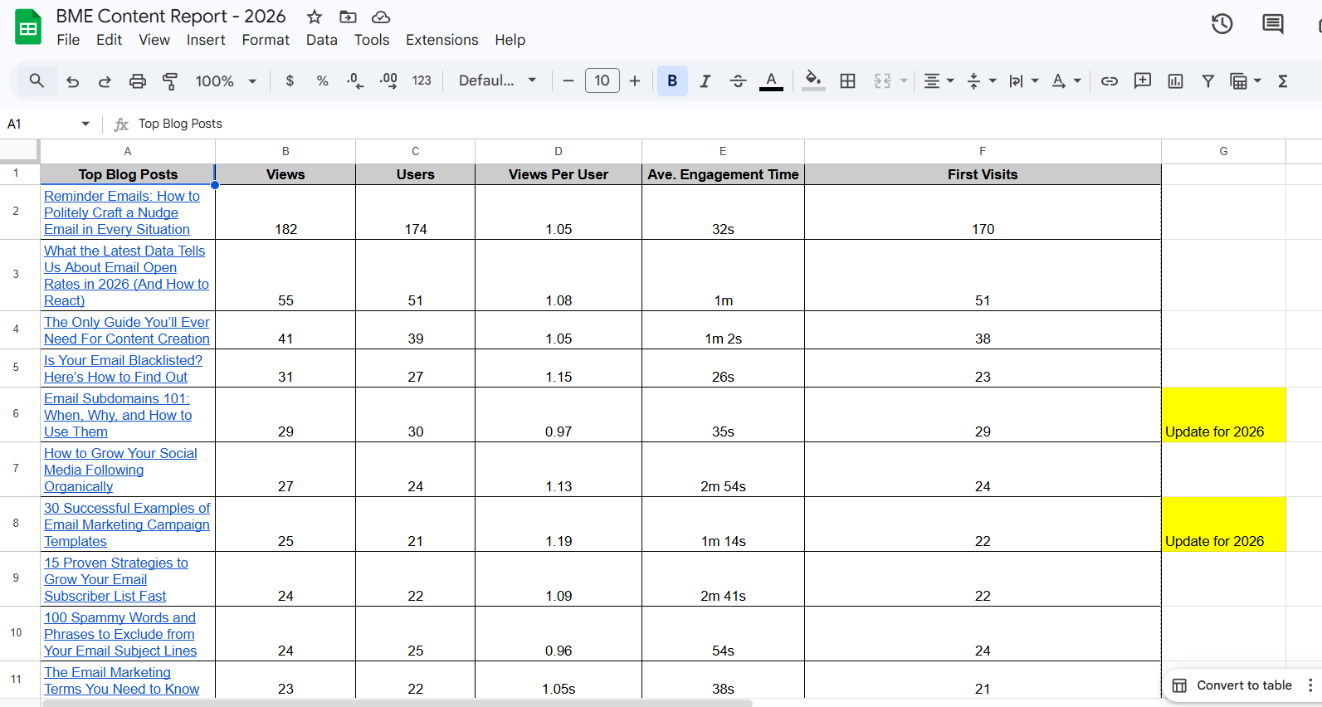
Validate Ideas
06
Recommendations and content report
We don’t guess. We validate.
Notes:
The other view we rely on heavily is "Almost Page One.” These are posts that are currently ranking on page two of Google. These are pages that are already working, just not working hard enough yet. A focused refresh, tightening the writing, updating stats, adding a new section, can push them onto page one in a way that publishing something brand new never could. We also cross-reference this with our content performance report to see which posts are driving the most traffic and engagement so we know where to focus our optimization efforts.

Slide 8
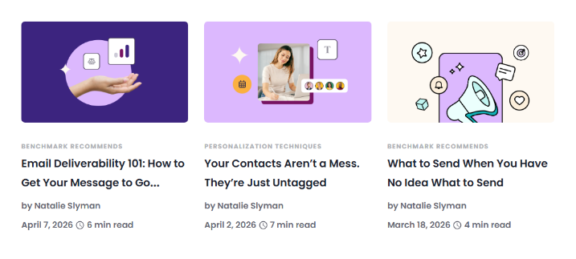
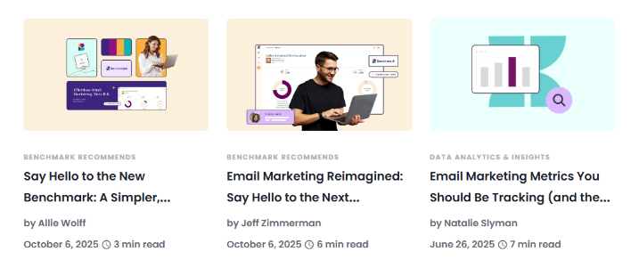
Double Down on What Works
07
Update > reinvent
Optimize high-performing posts
Focus on “Benchmark Recommends”
Notes:
The default instinct for most content teams is to always be writing something new. We've shifted away from that. When we have a post that's already ranking and accumulating traffic, the worst thing we can do is publish a second post on the same topic. It splits the SEO value and confuses search engines about which page to prioritize. Instead, we invest time in making the existing post better. The "Benchmark Recommends" series is a good example of content we actively maintain and optimize because it's foundational to how we position our expertise.

Slide 9
Add Timely Content
08
We stay flexible
Product updates
Industry changes
New customer questions
Notes:
While evergreen content is our foundation, we stay flexible enough to respond to what's happening in the market. When a major competitor changes their pricing, when a new platform feature launches, or when customers start asking a new set of questions, we want to be in that conversation quickly. Being responsive isn't about chasing trends; it's about being useful when people are actively looking for answers.

Slide 10
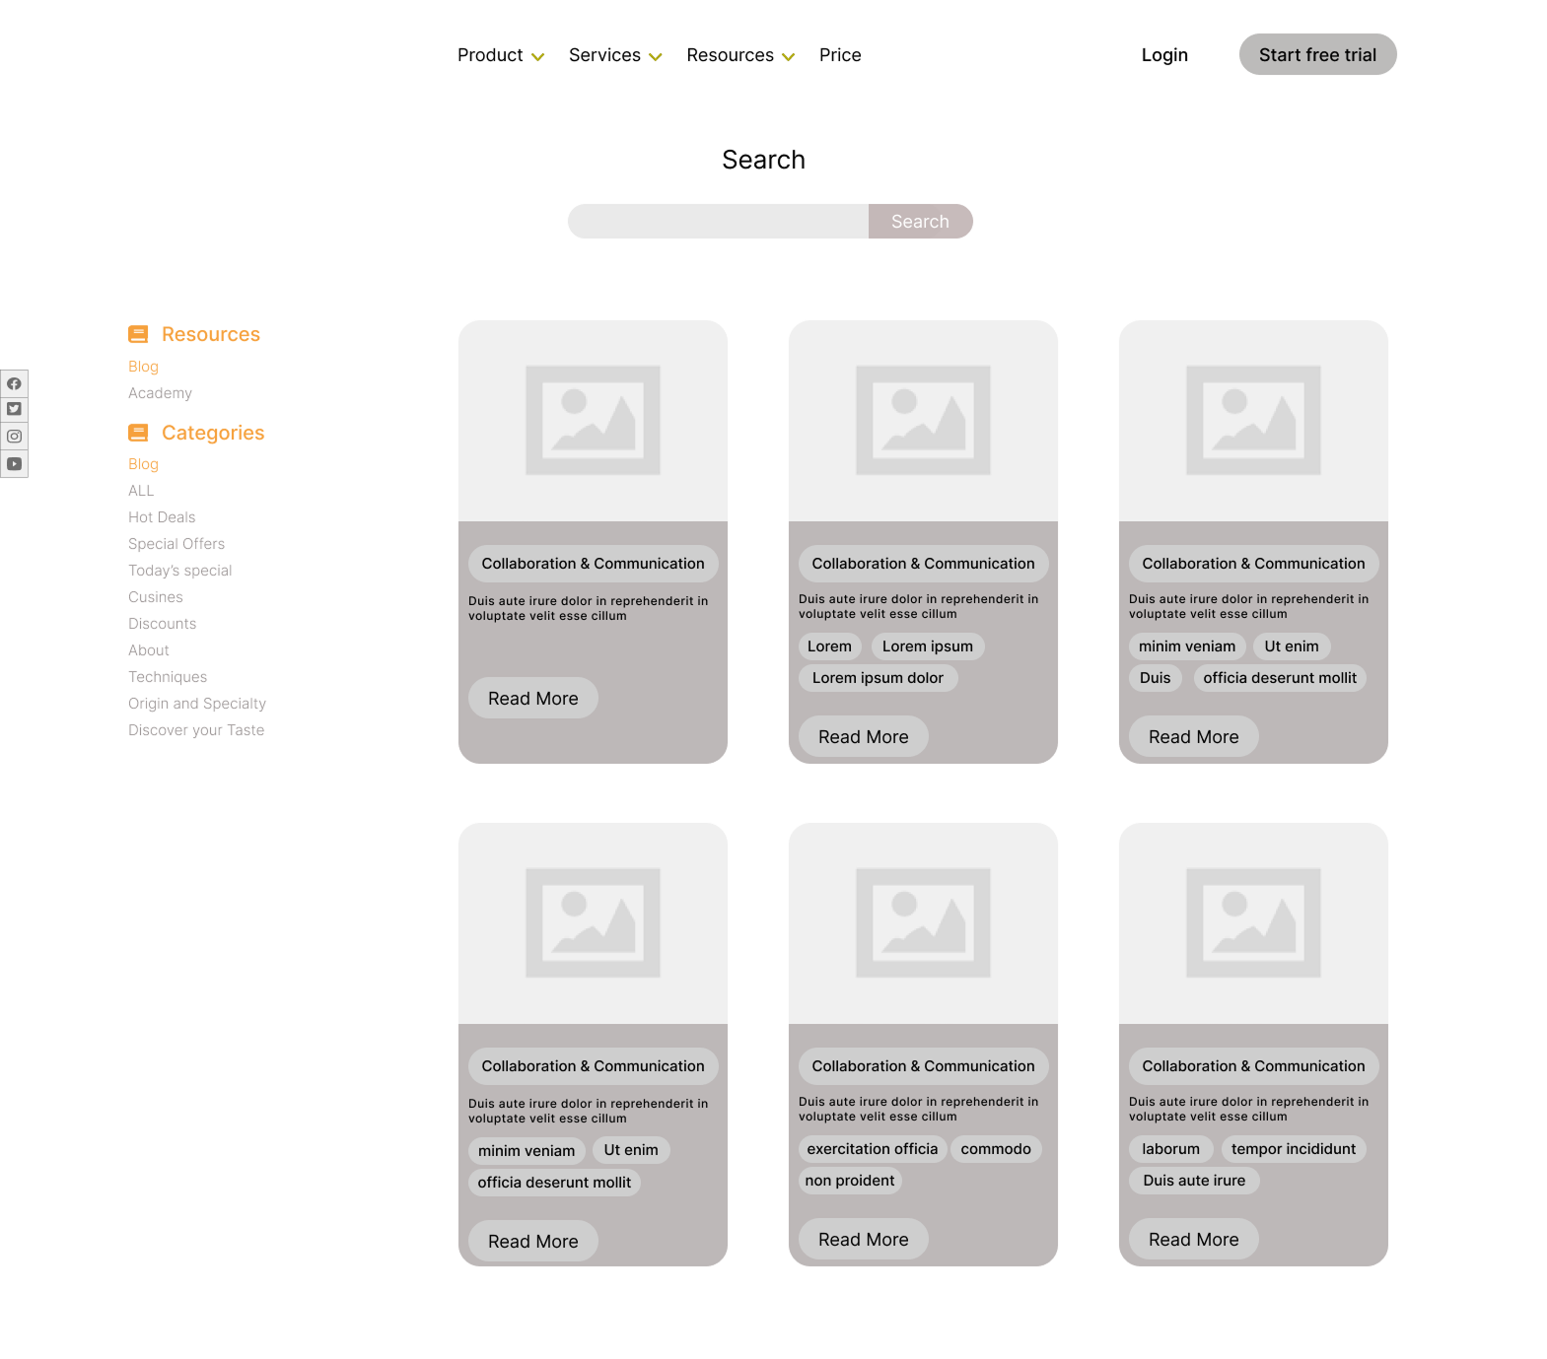
Structure & Optimize
09
Built for search + AI discovery
FAQ sections
Answer repeated questions directly.
Strong headings
Make the page easy to scan and easy to cite.
Clean formatting
Improve readability for humans and machines.
Notes:
Writing good content is only part of the job. How you structure it matters just as much, especially now that AI search is becoming a major discovery channel alongside traditional Google. We build every post with FAQ sections that directly answer the questions people are searching for, strong headings that make the page easy to scan and easy for AI tools to cite, and clean formatting that reduces cognitive load for the reader. The goal is for someone with 90 seconds to still get the main idea, while rewarding anyone who reads the whole thing.

Slide 11
Review & Edit
10
AI helps. Humans refine.
Messy draft
Clean final
Too long
Too dense
Too rough
Clear
Simple
On-brand
Notes:
This is the step most "we use AI for content" stories skip over. AI is genuinely useful for drafting, framing, and speeding up production, but every output needs a human editor before it goes anywhere near the publish button. AI will confidently include an uncited statistic, use phrasing that doesn't sound like us, or pad a section that should be three sentences. The edit pass is where we catch all of that, make sure the voice is right, verify any claims that need verifying, and turn a messy draft into something clean, clear, and on-brand.

Slide 12


Add Value
11
Make it actionable
Internal links
External links
CTAs
Images
Notes:
Before a post goes live, we make sure it's actually doing something for the reader beyond just answering their question. That means adding internal links to related content that keeps them on the site, external links that add credibility and context, CTAs that connect the content to a relevant next step, like a guide, a free trial, a related resource, and images that support comprehension and break up the page visually. Each of these elements turns a standalone article into something that actively works within a larger content ecosystem.

Slide 13

Publish
12
Content becomes a team asset
Sales
Customer service
Published content
Marketing
HR
Notes:
Publishing is not the finish line, it's the starting point. The moment a piece of content goes live, it becomes a team asset. Sales can use it in follow-up emails. Support can send it to customers who have a recurring question. Marketing can pull it into email campaigns and drip sequences. HR can reference it for onboarding. The value of published content multiplies when the whole team knows it exists and knows how to use it. If a piece goes live and just sits there, it's not doing its job.

Slide 14
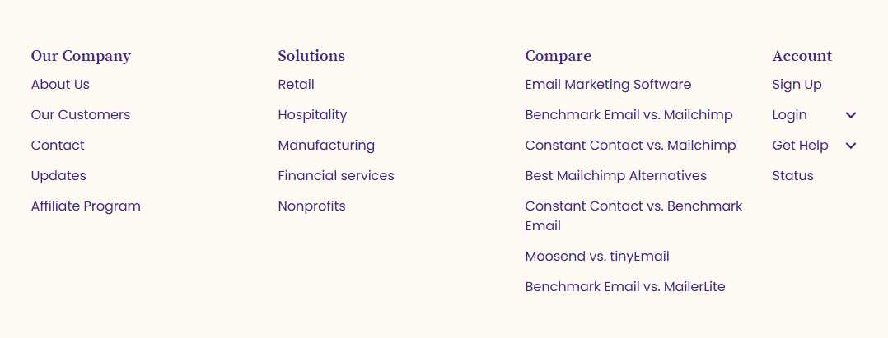
Pillar Content
13
Our foundation
Email Marketing Guide
Email Marketing Software
Notes:
Pillar content is the foundation of our SEO strategy. These are the big, authoritative pages, like our Email Marketing Guide, our Email Marketing Software page, and our comparison pages, that anchor our presence in search results for the most important topics in our category. Everything else we publish connects back to these pillars in some way. They're the pages we protect, update regularly, and make sure are always the strongest versions of themselves.

Slide 15

Evergreen Content
14
Always working in the background
Email Segmentation 101
1
Email Deliverability 101
Email Marketing Metrics
1
The ROI of Email Marketing
Notes:
Evergreen posts are the workhorses of our content library. Topics like Email Segmentation 101, Email Deliverability 101, Email Marketing Metrics, and The ROI of Email Marketing don't go stale, they stay relevant month after month and continue driving traffic long after they're published. These are the posts we refresh rather than replace, and they're often the most useful pieces for the sales and support teams because they answer foundational questions that prospects and customers ask repeatedly.

Slide 16
How Sales Can Use Content
15
✉️
Support outreach
❓
Answer questions
Give prospects useful context earlier.
Send the clearest explanation fast.
↺
Re-engage leads
📣
Share on social
Restart the conversation with value.
Stay visible without writing from scratch.
Notes:
Content is one of the most underused tools in most sales workflows. Instead of a generic check-in email, a relevant blog post gives a prospect something genuinely useful, and signals that you understand what they're dealing with. If someone on a demo asks about deliverability, there's already a post for that. If a lead has gone quiet, a timely piece of content can restart the conversation with value instead of pressure. And for staying visible on social without starting from scratch every week, published content is the easiest raw material you have.

Slide 17
Real Example
16
Instead of this
Try this
“Just checking in.”
“Thought this might help.
It breaks it down simply.”
Feels generic
Adds no value
Easy to ignore
Link to a relevant blog post
Notes:
This is the practical version of the previous slide. "Just checking in" is one of the most common and least effective follow-up approaches, it asks for attention without offering anything in return. Compare that to: "Thought this might help. It breaks it down simply," followed by a link to a relevant post. Same intent, completely different value exchange. The prospect gets something useful. You get a reason to be in their inbox that doesn't feel like a nudge. That's content doing sales work without the salesperson having to write something from scratch.

Slide 18
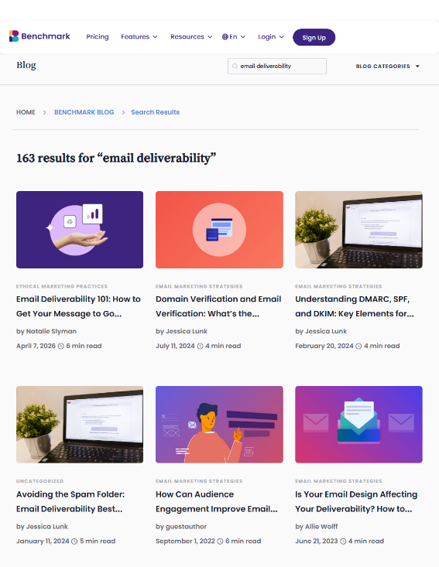
How to Find Content
17
Finding content is simple
1 Search the blog
2 Ask me via Slack
3 Request something new
Notes:
Finding what we've already published is straightforward. The fastest option is searching the blog directly. We have tons of posts on email deliverability alone, so whatever topic you need, there's likely something already there. If you're not sure what exists or need help finding the right piece for a specific situation, reach out via Slack. And if you have a topic in mind that we haven't covered yet, put in a request. The best content ideas often come from the people closest to the customer conversation.

Slide 19
18
Create less. Use more.
Build the right assets for the whole team to use with confidence.
The right content makes your job easier
Thank you
Notes:
The takeaway from everything we've covered today isn't "make more content." It's "use what already exists more deliberately." The content library we've built is a team resource. It's there to make sales easier, support faster, and marketing more consistent. The goal is to build the right assets and then make sure everyone on the team can use them with confidence. That's what makes content a compounding investment rather than a one-time effort.

